Slide 1
SPEECH TO SIGN LANGUAGE TRANSLATION.
PROJECT
KIRAN SAMANT BE/C 17EE2026
PRATHMESH SANKPAL BE/C 17EE1101
ANUJA SALVI BE/C 17EE2006

Slide 2
INTRODUCTION
Sign languages (also known as signed languages) are languages that use the visual-manual modality to convey meaning. Sign languages are expressed through manual articulations in combination with non-mutual elements.Sign languages are full-fledged natural languages with their own grammar and lexicon. Sign languages are not universal and they are not mutually intelligible with each other, although there are also striking similarities among sign languages
So far, we had the opportunity of using Speech Recognition to convert it to text. The new idea that we shall be proposing in this project will be the incorporation of Speech to Text, Text-Sign Language using various applications and combining each independent function to together form a better application in totality.

Slide 3
PROBLEM STATEMENT
AROUND 1.3 MILLION PEOPLE IN INDIA HAVE HEARING IMPAIRMENT, AND NOT EVERYONE KNOWS SIGN LANGUAGE AND WHEN THERE IS AN ENCOUNTER WITH PEOPLE WHO ARE HAVING HEARING IMPAIRMENT, THERE CAN ARISE A SITUATION WHERE WE MIGHT HAVE TO COMMUNICATE WITH THEM, FOR THIS WE HAVE CREATED A SPEECH TO SIGN LANGUAGE TRANSLATOR, WHICH TAKES OUR SPEECH AS THE INPUT AND COVERTS THEM TO SIGN LANGUAGE AND DISPLAYS IT AS GIFS OR IMAGES.

Slide 4
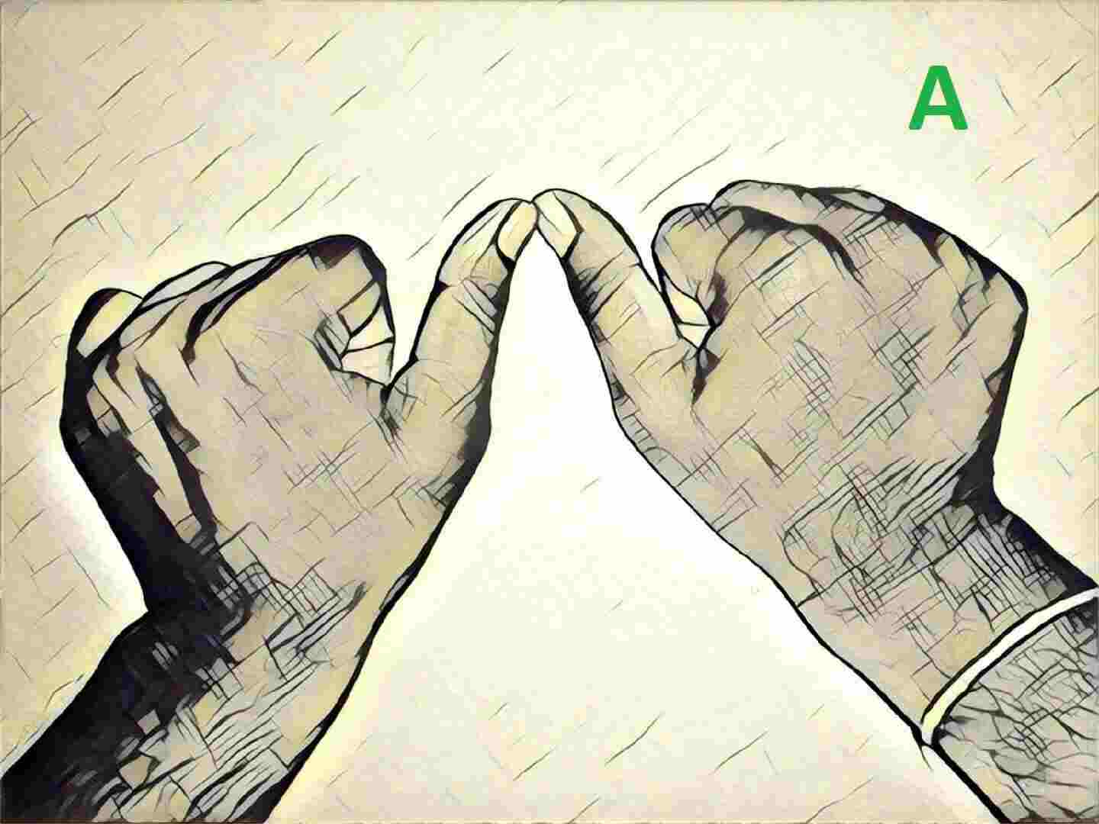
CURRENT SCENARIO
AROUND 1.3 MILLION PEOPLE IN INDIA HAVE HEARING IMPAIRMENT.
COMMUNICATING WITH THEM IS DIFFICULT IN REAL TIME SITUATIONS.
ISL IS LENGTHY AND CAN TAKE TIME TO LEARN AND MASTER.
DAILY PROBLEMS ARE FACED BY PEOPLE WITH HEARING IMPAIRMENT AS PEOPLE DONT HAVE AN EFFECTIVE MEANS TO COMMUNICATE WITH THEM.
SEVERAL APPLICATIONS HAVE TO BE USED TO CONVERT A FOREIGN LANGUAGE TO ISL.
ITS REAL TIME INCORPORATION IS A TASK THAT HAS TO BE TACKLED.

Slide 5
WHY WE WENT AHEAD WITH THIS PATICULAR METHOD?
There are already many such applications available that convert speech to text and then there are applications that convert text to sign language, we decided to incorporate these to together and giving you a speech to text to sign language translator.
The disadvantages of the already present systems were, that they either followed the ASL(American Sign Languages) or could only take input in a particular and specific languages.
We have tried our best to overcome these limitations in our model.

Slide 6
OUR MODEL.
The biggest advantage of out model is that, it takes the speech input in any language, be it Hindi, Spanish, French, our model can recognize that speech, further this speech is translated to English and the Indian Sign Languages are available.
The second adavantage would be, our sign languages are in shown in video and gifs form.
And its very easy to understand and use, the user must have a microphone in hand and our system would help them communicate with the impaired person.

Slide 7
IMPLEMENTATION
The modules we have used are:
EasyGui is used for the front end.EasyGUI is a module for very simple, very easy GUI programming in Python. EasyGui provides an easy-to-use interface for simple GUI interaction with a user.
PyAudio is used to take the speech input through the microphone PyAudio provides Python bindings for PortAudio, the cross-platform audio I/O library. With PyAudio, you can easily use Python to play and record audio on a variety of platforms.
Speech recognition is done using Google API an the python speech recognition module “SpeechRecognition” is used. This module even configures the microphone, so we need to give the speech input via the microphone.
Text processing is done using NLP(Natural Language Processing). NLP is a subfield of computer science and artificial intelligence concerned with interactions between computers and human (natural) languages. It is used to apply machine learning algorithms to text and speech.
Once the speech is converted into text, we have to match it with our dataset to either display the gifs or the letters.

Slide 8
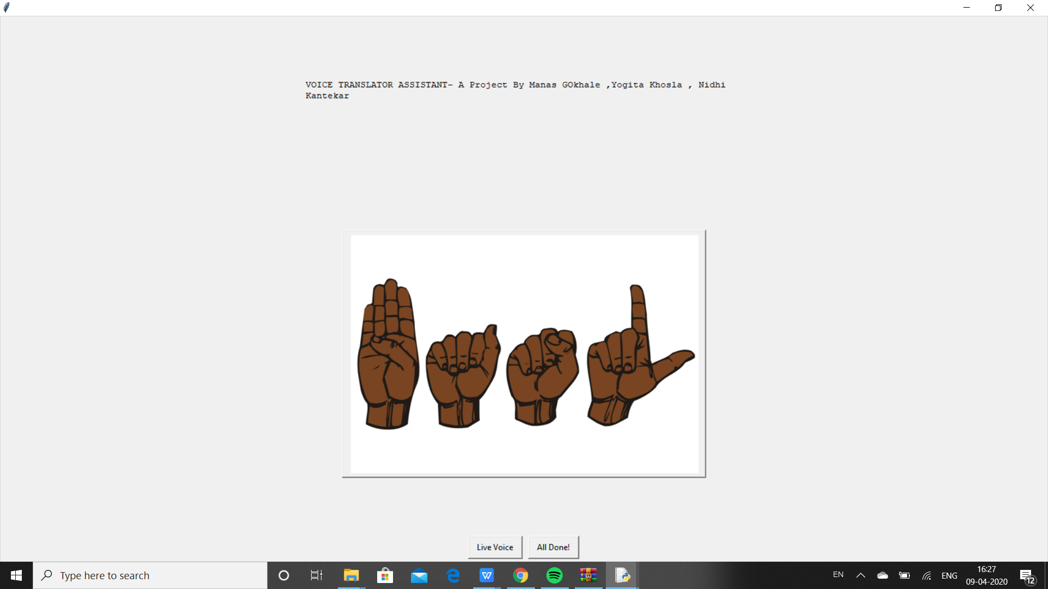

Slide 9
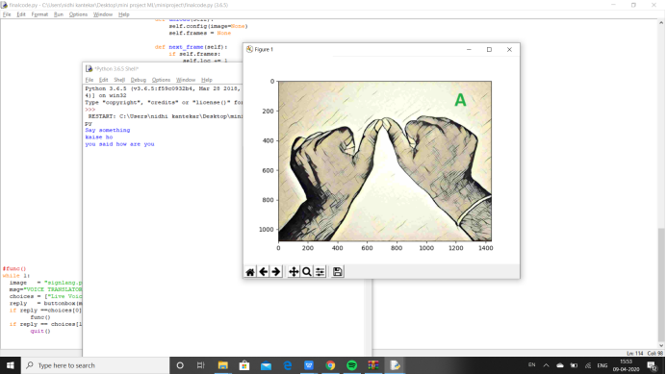

Slide 10
MODULES USED
SpeechRecognition : pip install SpeechRecognition
Googletrans: pip install Googletrans
Numpy: pip install numpy
Matplotlib : pip install matplotlib.pyplot
CVS: pip install opencv-python
EasyGui: pip install easygui
OS: pip install os-win
PL: pip install Pillow
Itertools: pip install itertools
Image: pip install image
Tkinter: pip install tkinter
String: pip install string

Slide 11
CONCLUSION
The Speech to Sign Language Translator can bring a huge revolving change in the lives of many. It’s has gone through the process of trail and tests to obtain a smooth working model which can be implemented for socials causes and for any other necessary occasions.
We have made sure that the user doesnt have to keep changing applications to translate foreign language to engllish and further to sign language by combining and making this an effective one stop system that is easy to use .
Much more development on this track can be done as the ISL dictionary is still small and needs to grow eventually. In the Future we can add support for the Sign Languages of other countries and making it more portable by mitiating it to web and application based platforms.
Implemented and tested successfully

Slide 12
THANK YOU.

